Slide 1

AI Guru: AI-Powered Platform for JEE Exam Preparation
Team Name: DevVerse
College Address: SISTec Gandhi Nagar Campus, Bhopal (462036)
Name of Leader: Meer Humayu
Submission Date: September 5, 2025

Slide 2

Addressing Student Challenges in Competitive Exams
Area Overview: Competitive Exam
Competitive exam like JEE are crucial gateways for students, but they come with immense pressure and unique learning challenges.
Why AI?
Artificial Intelligence offers a powerful solution to personalize and significantly improve the learning experience, adapting to individual student needs.
Our Motivation
We aim to solve the pervasive problem of students getting "stuck" during self-study, which often leads to frustration and wasted time.

Slide 3

Bridging the Gap: Challenges vs Opportunities
Challenges
Doubt Blindness: No 24/7, instant help for specific queries.
Learning in Isolation: Can be lonely and inefficient without peer interaction.
Language Barrier: Difficulty understanding complex concepts in English for non-native speakers.
Opportunities with AI
Instant Expert Answers: AI can provide immediate, accurate solutions.
Smart Peer Connections: AI can facilitate collaborative learning among students.
Bilingual Support: AI can break down language barriers for better comprehension.

Slide 4



AI Guru: Our Solution Concept
Introducing AI Guru, a smart doubt-solving platform designed to revolutionize competitive exam preparation.
Student Input
AI Guru Processes
Solution Delivered
Help in Seconds
Bilingual Solutions
Peer Support
Get answers almost instantly, eliminating long waiting times and keeping the learning flow uninterrupted.
Receive step-by-step solutions in both Hindi and English, ensuring clarity and deeper understanding.
Leverage peer knowledge-sharing features to learn from others and collaborate on challenging problems.

Slide 5



Key Features & Functionalities
Personalized Interactions
24/7 Bilingual Support
Smart Doubt Rooms
Interact with AI Guru using photos, voice commands, or text input for maximum convenience.
Access assistance anytime, anywhere, with comprehensive support in both Hindi and English.
Engage in collaborative learning environments, connecting with peers to discuss and solve doubts together.
These features ensure a flexible, comprehensive, and interactive learning experience tailored to modern students.

Slide 6




Target Users & Expected Use Case
Target Audience: Students rigorously preparing or Joint Entrance Examination (JEE).
Student Gets Stuck
Snap & Submit
A student is studying late at night and gets stuck on a complex problem, with no one available to help.
The student simply snaps a photo of the problem using their phone and uploads it to AI Guru.
Instant Explanation
Connect & Discuss
AI Guru immediately explains the solution in both Hindi and English, breaking it down step-by-step.
If further clarification is needed, AI Guru connects the student to a peer in a 'Smart Doubt Room' for discussion.
This seamless flow ensures no student remains stuck, fostering continuous learning.

Slide 7

Data Requirements & Privacy Considerations
Data Needed for Optimal Performance
Doubt Submissions: Text, image, and audio inputs from students.
Performance Data: User interaction logs, solution ratings, and progress metrics.
This data is crucial for training our AI models and continuously improving the accuracy and relevance of solutions.
Our Commitment to Privacy
Anonymization
Encryption
All personal identifiers are removed from student data.
Data is encrypted during transit and at rest to prevent unauthorized access.
Secure Storage
We use industry-standard secure servers to protect all collected information.

Slide 8



Powering AI Guru: Technology and Methods
Natural Language Processing (NLP):
Machine Learning (ML):
Large Language Models (Gemini Pro):
To power the recommendation engine for peer matching in "Smart Doubt Rooms."
Speech-to-Text & NLP: To process and comprehend user queries in voice and text formats.
For contextual analysis, problem-solving, and solution generation.
Overall Effect: These integrated AI technologies enable AI Guru to precisely identify confusion points and deliver highly effective, tailored solutions.

Slide 9
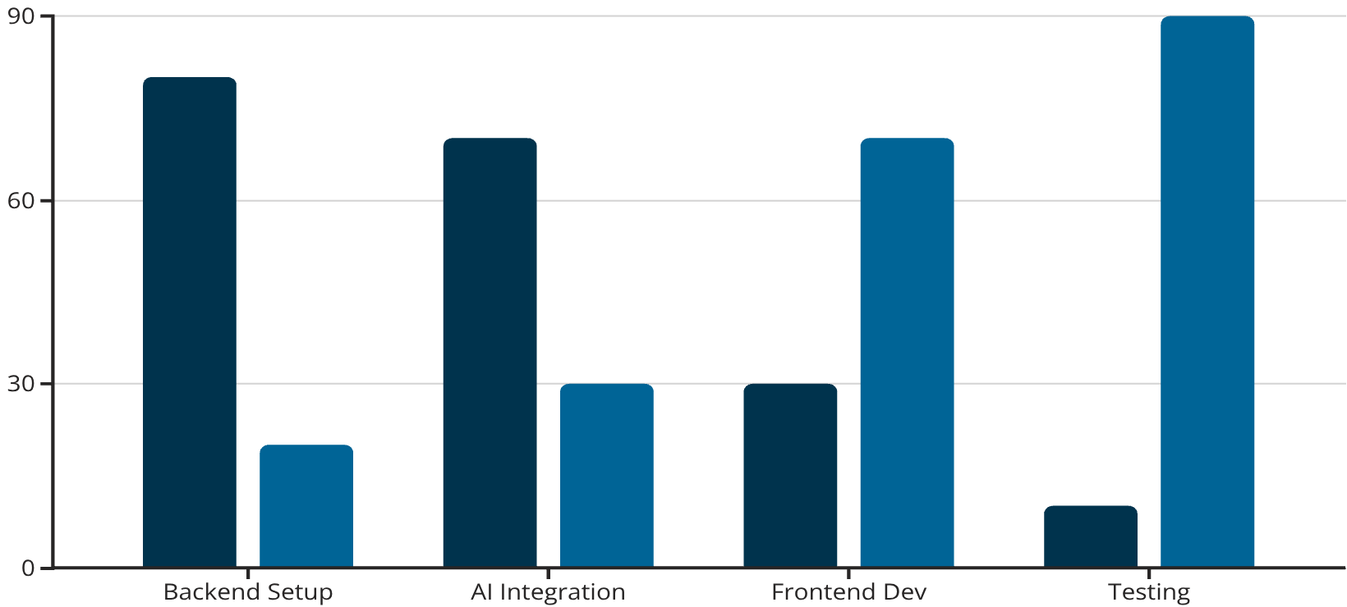
Hackathon Implementation Approach
Our focus for this 48-hour hackathon is to develop a functional prototype.
Core Tools & Technologies:
MERN Stack: For robust full-stack development (MongoDB, Express.js, React.js, Node.js).
Google Gemini API: Leveraging advanced AI capabilities for powerful doubt-solving and language translation.
Day 1
Day 2
Deliver a dynamic and impactful demo within the hackathon's timeframe with our agile approach.

Slide 10


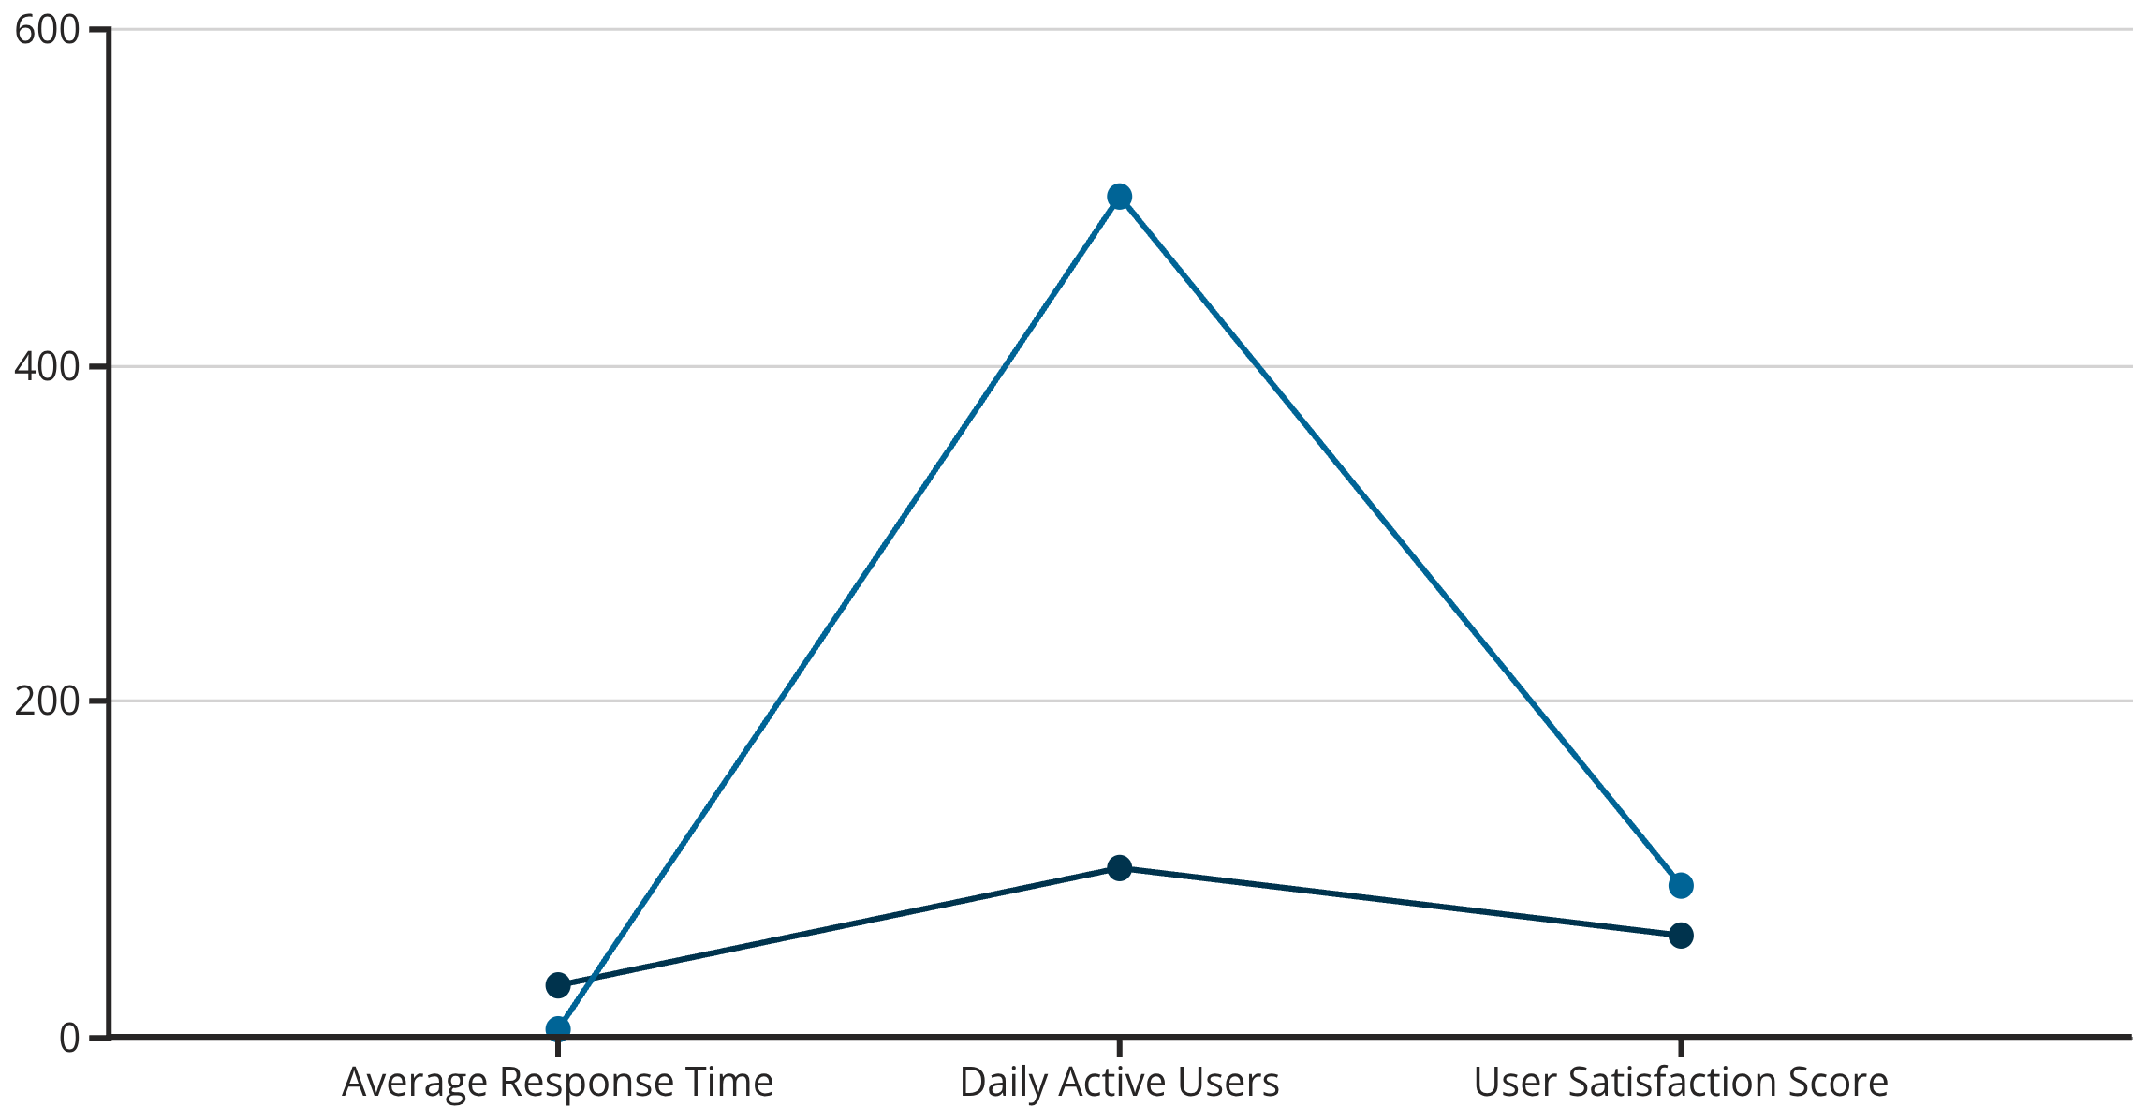
Measuring Success: Evaluation Metrics
AI Guru's impact will be measured by its ability to foster:
Faster Learning
Higher Confidence
More Engagement
Reduced time spent struggling with doubts.
Empowering students with immediate, clear solutions.
Keeping students motivated and interested in their studies.
Key Performance Indicators (KPIs):
Baseline
Target Improvement
AI Guru is designed to make a measurable difference in competitive exam preparation.

Slide 11

Thank You for Your Time
We appreciate your attention and hope you share our vision for revolutionizing competitive exam preparation with AI Guru.
Your feedback and questions are invaluable as we continue to develop this solution.
Let's connect and build the future of education together!
Team DevVerse

